Slide 1
JavaScript Callback Functions & Form Validation Revisited
Amrita University

Slide 2

From Validation - Revisited

Slide 3
Passing JavaScript Functions as Variables Revisited
function functionName() { // some code }
This is a JavaScript Function
A function is a block of code that will be executed when you call it
A function is written as a code block inside curly { } braces, preceded by the function keyword
The code inside the function will be executed when you call the function

Slide 4
Passing JavaScript Functions as Variables Revisited
function functionName(var1, var 2) { // some code }
functionName(argument1, argument2);
When you call a function, you can pass along some values to it, these values are called arguments or parameters.
These arguments can then be used inside of the function.
You can send as many arguments as you like, separated by commas (,)
To use the arguments inside of the function, you must declare the arguments as variables when defining the function
The variables and arguments must be in expected order.
That is, the first argument gets assigned to the first variable.

Slide 5
Passing JavaScript Functions as Variables Revisited
function functionOne(x) { return x; };
function functionTwo(var1) { // some code }
functionTwo(functionOne);
You can assign functions to variables, and because functions are objects in JavaScript, you can pass functions to other functions as variables. Which means that in this case, we are passing functionOne as a variable to be used inside of functionTwo
Inside of functionTwo, var1's value will be functionOne
This is how you can pass functions to other functions in JavaScript.
In this case, functionTwo can use functionOne inside of it.

Slide 6
JavaScript Callback Functions
Method of passing in functions to other functions to use them inside is used in JavaScript libraries almost everywhere.
The common name for the function passed in is a callback function.
A callback is a piece of executable code that is passed as an argument to other code, which is expected to call back (execute) the argument at some convenient time.
The invocation may be immediate as in a synchronous callback or it might happen at later time, as in an asynchronous callback.
Function One takes in an argument and issues an alert with the x as it's argument.
Function Two takes in an argument and a function.
Function Two then passes the argument it took in to the function it took in.
Function One is the callback function in this case.
function functionOne(x) { alert(x); }
function functionTwo(var1, callback) {
callback(var1);
}
functionTwo(2, functionOne);

Slide 7
JavaScript Callback Functions - Anonymous
function functionTwo(var1, callback1) {
callback1(var1);
}
functionTwo(1, function (x) { alert(x); })
In this case, the callback function is defined when we are calling functionTwo.
Call the callback function inside of functionTwo as many times as we like.
There is no limit to how many times we can call it.
function functionTwo(var1, callback) {
callback(var1);
callback(var1);
}
functionTwo(1, function (x) { alert(x); })

Slide 8
One More Example
function functionTwo(var1, var2, callback1, callback2) {
callback1(var1);
callback2(var2);
}
functionTwo(1, 2, function (x) { alert(x); }, function (x) { alert(x); })
Here in function two we pass in two variables and two functions as arguments.
Inside of function two, we run callback1 with variable 1 and we run callback2 with variable 2.
Passing the number 2, the functionOne function and an anonymous function
functionTwo(2, functionOne, function(x) { alert(x+2); });
The anonymous function will alert the result of adding two to the number that was passed into it.

Slide 9
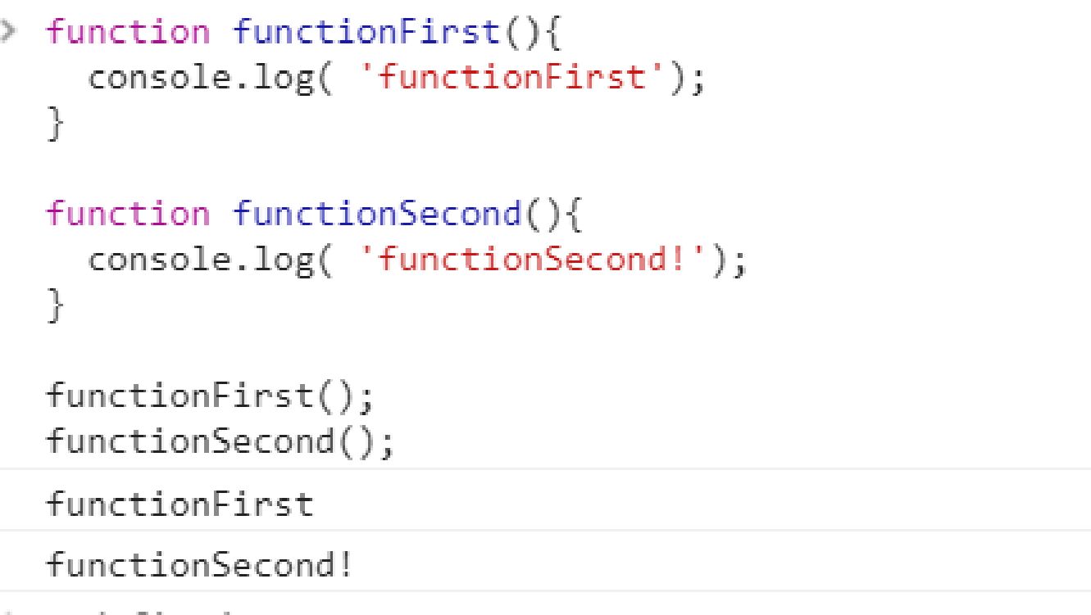
Asynchronous javascript: callbacks

Slide 10
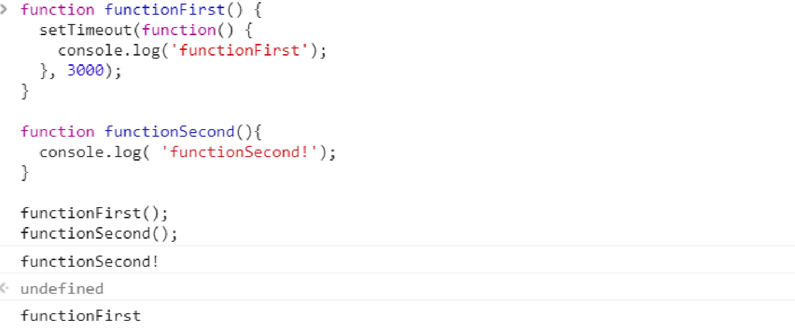
Asynchronous javascript: callbacks
Why? Javascript is of a single threaded nature.
This means it executes one piece of code at a time (each piece of code, or operation, is queued along this single thread).
Notice how functionFirst() triggers setTimeout, which queues an operation to run after a certain delay (in this case, after 3 seconds).
The concept of running after a certain time is exactly what asynchronous means.

Slide 11
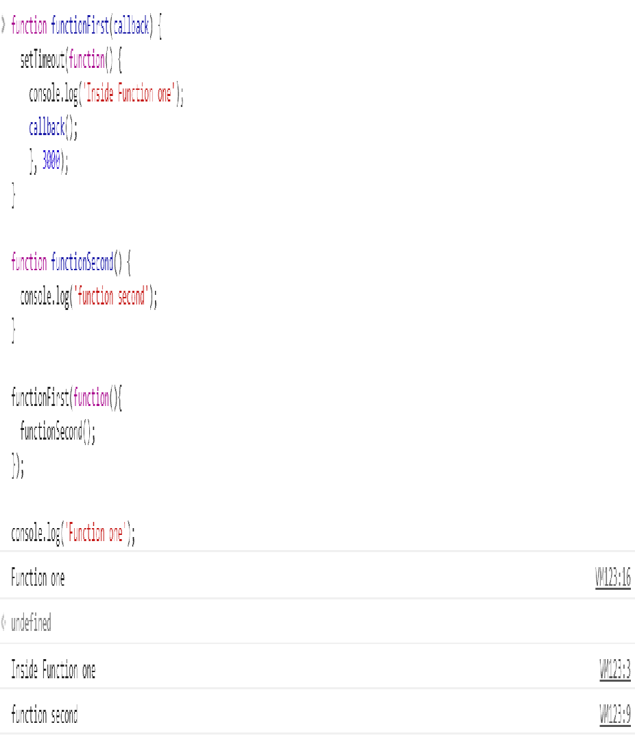
Asynchronous javascript: callbacks
functionFirst accepts functionSecond as an argument, or callback, and this means that functionFirst is a higher-order function.
In other words, functionFirst will call the second function back later once its operation is complete.

Slide 12
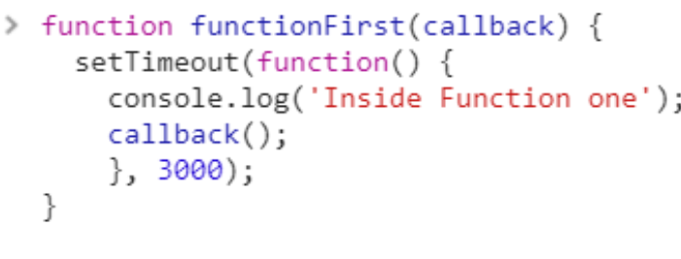
So why is this useful?
Say you send off an HTTP request and you need to do something with the response.
Instead of holding up your browser, you can use a callback to handle the response whenever it arrives.
Another useful example in this context could be when your application is dependent on user input.
The only reason I used setTimeout was to simulate an operation that takes a certain time.
Such operations could be reading from a text file, downloading things or performing an HTTP request.

Slide 13
So why is this useful?
Node, for example, is built entirely on an asynchronous concept and uses callbacks extensively.
var fs = require("fs");
fs.readFile('input.txt', function(err, data) {
if (err) return console.error(err);
console.log(data);
});
Notice the first argument of the call back is reserved for an error object.
This is the error callback convention that has been standardized to allow for Node’s asynchronous nature.

